Slide 1
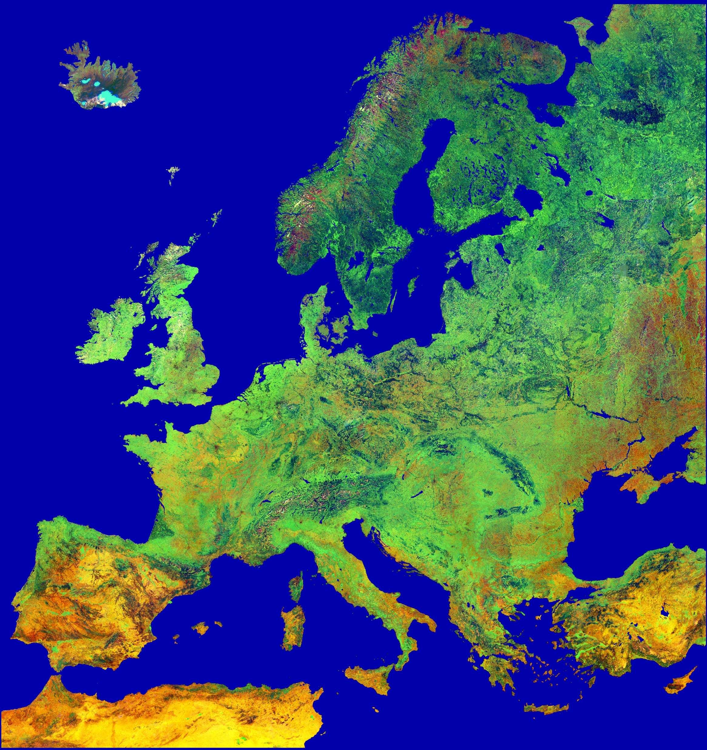

ClimateWins: Predicting Climate Change with Machine Learning
Climate Strategy Proposal
Presented By:
Olufemi Ige
February 2026

Slide 2
Executive Summary
Europe’s climate regimes remain structurally stable but increasingly variable.
ML can detect anomalies and forecast exposure risk but cannot score habitability alone.
Additional data (infrastructure, population, resilience) is required for full risk assessment.
ML provides early‑warning signals but requires socioeconomic data for actionable planning.

Slide 3
CLIMATEWINS OBJECTIVES
ML APPROACH
Combine unsupervised learning, deep learning, and optimization techniques
Leverage 60+ years of European weather data (18 stations, 1960-2022)
Apply advanced ML algorithms to detect patterns, predict trends, and assess regional risk
Find new patterns in weather changes over the last 60 years
Identify weather patterns outside the regional norm in Europe
Determine whether unusual weather patterns are increasing
Generate possibilities for future weather conditions over the next 25–50 years
Determine the safest places for people to live in Europe within the next 25–50 years
TRENDS
ANOMALIES
GROWTH
FORECAST
SAFETY

Slide 4
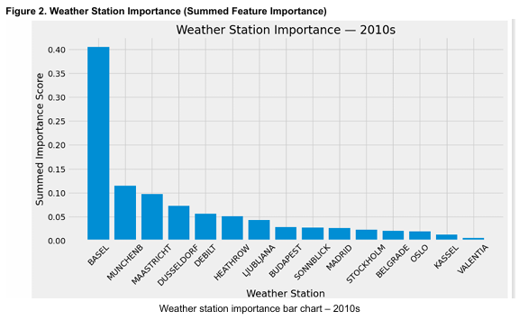
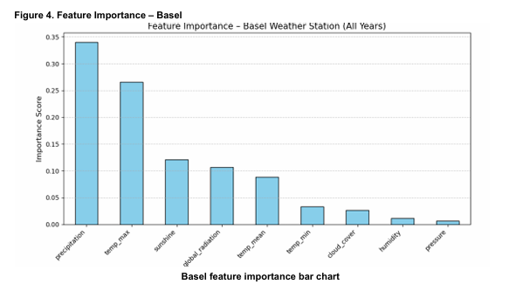
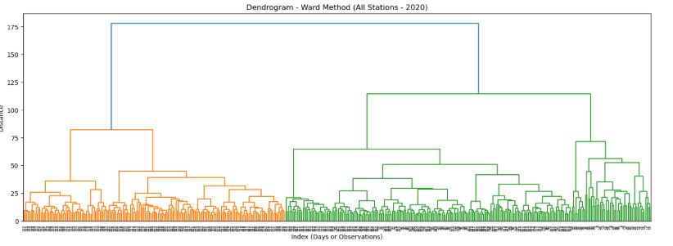
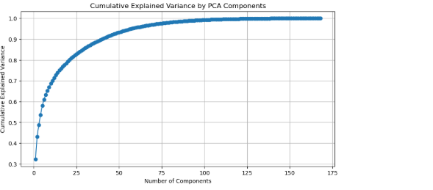
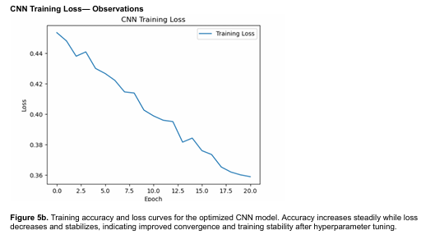
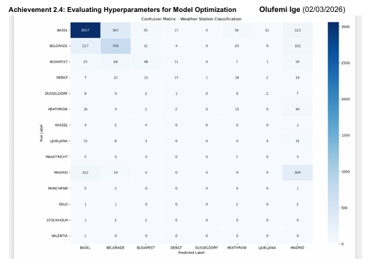
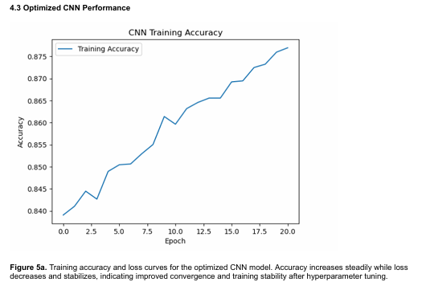
MACHINE LEARNING METHODS SUMMARY
Shows: Basel dominance, München and Maastricht contributions
Shows: Precipitation dominates, followed by max temp and sunshine
ML MODEL | PURPOSE
Unsupervised Learning: PCA (Principal Component Analysis) K-Means & Hierarchical Clustering | Dimensionality reduction to simplify data Identify natural groupings in weather patterns
Deep Learning Models: CNN (Convolutional Neural Networks) RNN/LSTM (Recurrent Neural Networks) | Learn complex multivariate patterns & interactions Capture temporal weather sequences
Optimization: Bayesian Optimization Random Forests | Find optimal hyperparameters efficiently Ensemble learning for robust predictions
Generative Models: GANs (Generative Adversarial Networks) | Generate & test synthetic extreme weather scenarios
Shows: Clear climate clusters separating station groups
Shows: Cumulative variance curve with elbow at 10 components
Shows: loss decreasing smoothly
Shows: Strong diagonal performance for well-represented stations
Shows: Accuracy rising

Slide 5
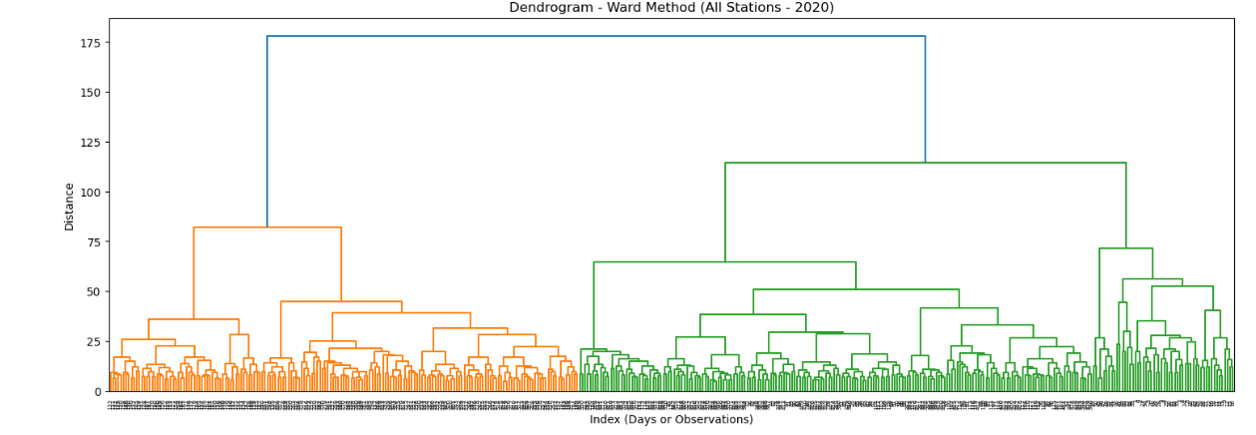
Thought Experiment #1:
Detecting Historical Climate Anomalies
Analysis Question:
Is it possible to detect weather patterns that deviate from the historical climatic norms of a region?
This Ward dendrogram shows tight climate clusters and highlights potential anomalies as observations that merge only at much higher distances.
Answer:
Yes — deviations from historical climate norms can be detected.
Hierarchical clustering reveals stable climate groups.
High‑distance merges indicate anomalies.
Deviations from long‑term norms are detectable.
Supports early warning for unusual weather behavior

Slide 6
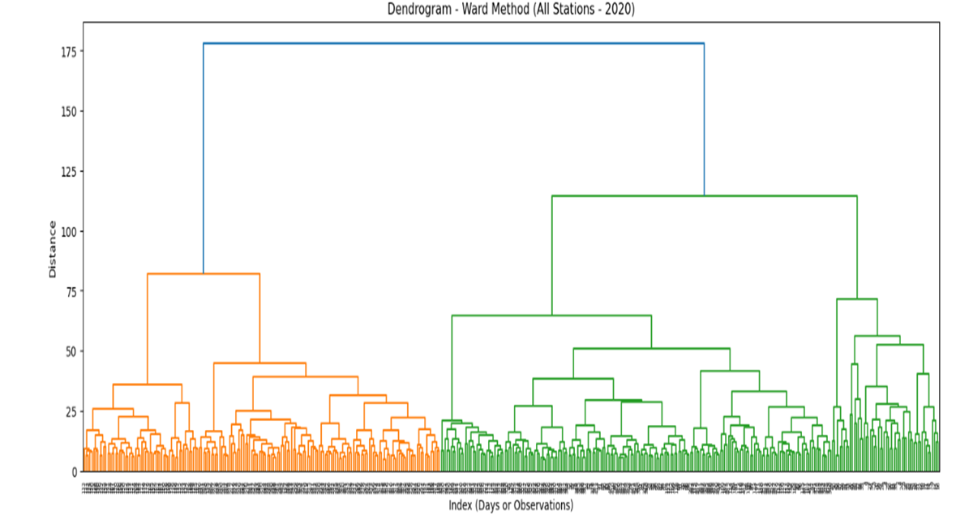
Thought Experiment #2:
Are Europe’s Climate Regimes Structurally Shifting?
Analysis Question:
Have Europe’s climate regimes structurally shifted over the past 60 years?
This diagram shows and identifies climate exposure thresholds that differentiate stable from volatile regions, forming a foundational layer for long-term habitability assessment.
Answer:
Yes, stable regional climate regimes remain statistically identifiable. Localized deviations exist, but there is no evidence of continent-wide structural breakdown.
Climate variability is increasing unevenly, not systemically.

Slide 7

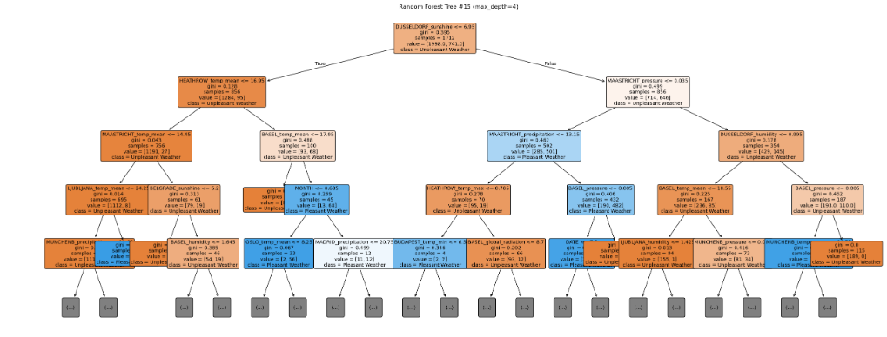
Thought Experiment #3:
Future Habitability: What ML Can and Cannot Predict Within 25–50 Years
Analytical Question:
Can ML help identify safer places to live in the future?
This diagram shows whether unusual weather patterns are emerging by highlighting stable clusters versus areas of localized variability.
Answer: Yes — partially and indirectly.
ML Can: detect regimes, track instability, model exposure
ML Cannot: determine habitability without infrastructure, population, and resilience data

Slide 8



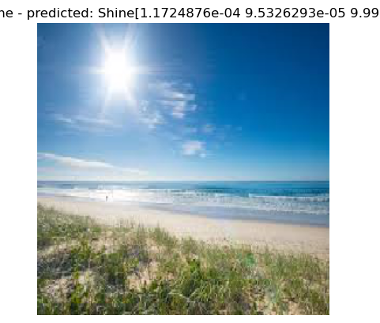
Data Gaps That Limit Habitability Scoring:
Critical Gaps:
Infrastructure resilience.
Population vulnerability.
Emergency response capacity.
Land use and urban density.
Exposure pathways.
Key Insights:
Weather alone cannot define long‑term habitability — risk and resilience matter equally.

Slide 9
Key Insights & Recommendations
Integrating ML structure, instability tracking, and exposure modeling creates a scalable climate‑risk framework.
Detect:
PCA + clustering to map stable regimes
Track:
CNN/LSTM to monitor instability over time
Decide:
Convert exposure thresholds into risk profiles
Expand:
Add infrastructure, population, emergency capacity
Validate:
Cross‑check with climate experts
Build:
Multi‑layer risk dashboard (Structure → Instability → Exposure)

Slide 10
Conclusion
ML reveals meaningful climate structure and emerging variability.
Europe’s climate is shifting unevenly, not collapsing.
A multi‑layer risk framework can guide long‑term planning.
Future work will integrate socioeconomic resilience data to produce a full habitability index.

Slide 11
Thank You For Your Attention
Please email me your questions and comments
Email address: feminoble8@gmail.com
Github: OlufemiGit (Olufemi)

